Slide 1

DSC640 Project task 5
Presented by
Edris Safari
Notes:
Hello everyone and thank you for choosing to view my presentation. This is the final deliverable for a study in data visualization. We turn data into pictures that we can get informed about something.

Slide 2
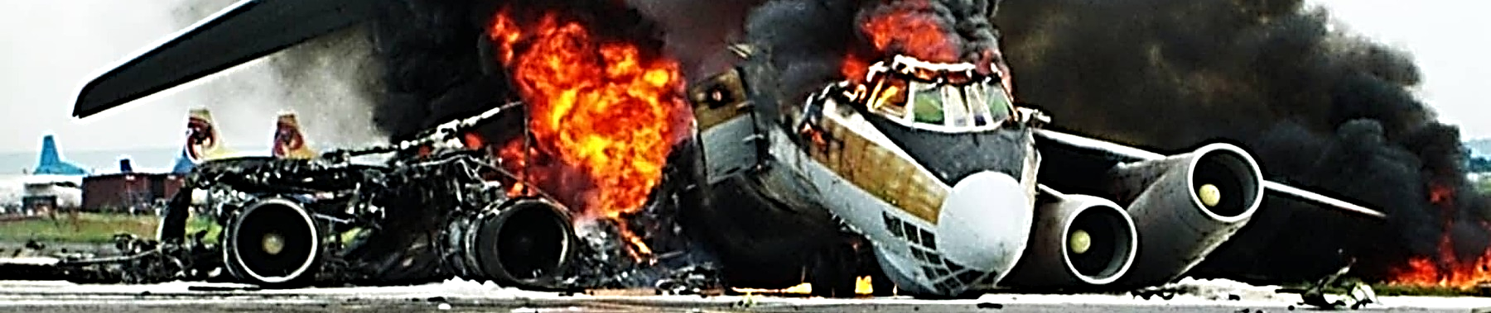
Notes:
You probably wonder why I am showing this ominous picture.

Slide 3
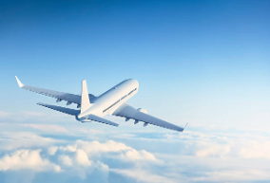
Notes:
That’s because I want to show this. A beautiful blue sky with a plane flying softly through it. I want to show you it’s not as bad as the media makes it out to be.
Today we are going to talk about airline travel and its safety.
When we hear about accidents with a lot of casualties. Or accidents with unknown and mysterious causes or just unexpected accidents, we and the media go crazy over safety issues. We make assumptions not based on facts.
In the next few minutes, I’m going to show you some pictures and graphs as we call it in data science. What’s data science? It’s the science of finding the truth using data.
I hope that using data, I can paint a different picture on airline travel and its safety. I’m going to show you accidents don't happen regularly, and fatalities have gone down over the years, and that traveling worldwide has increased in popularity and satisfaction.

Slide 4
Aviation Safety Network, Flight Safety Foundation
WorldBank Data:
https://data.worldbank.org/indicator/IS.AIR.PSGR?end=2020&start=1970&view=chart
Fatal and non-Fatal accidents from 1985 to 2014 by top 56 international airlines
US general Aviation Safety Data
US Carrier Safety Data
Number of miles traveled by all countries worldwide from 1960 to 2020
Airline passenger satisfaction
Notes:
I went on the web and searched for data. I got data from these two sources. Aviation Safety network and World Bank.

Slide 5
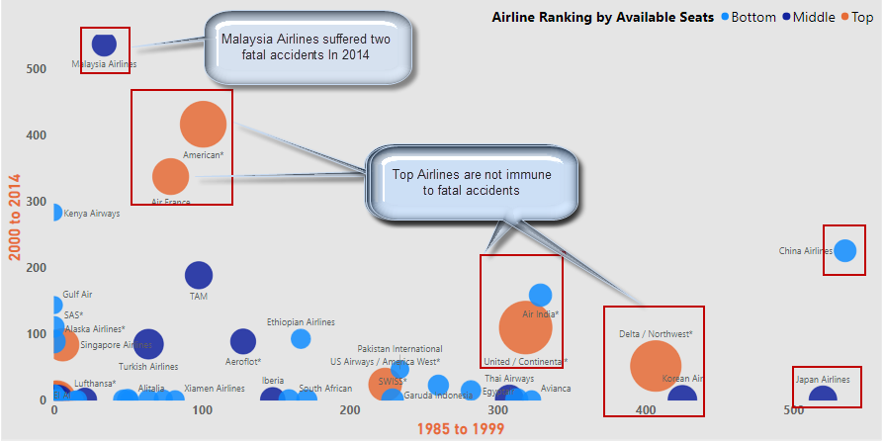
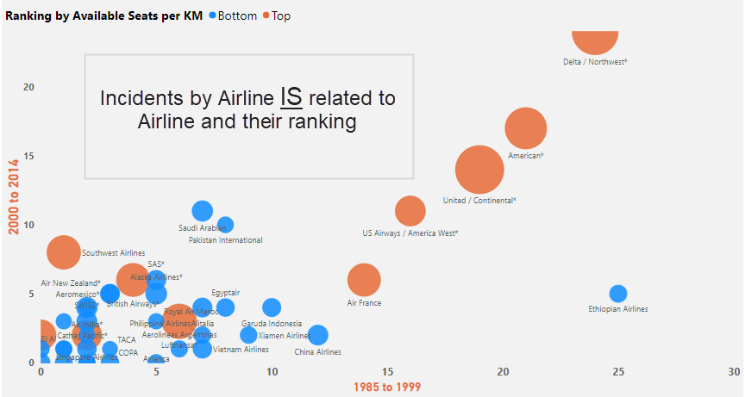
Notes:
This picture shows how we cannot predict fatal accidents. This graph shows there’s no correlation at least among these 50 airlines . The ones with bigger bubbles are the larger airlines.
Notice the Malaysian airline in 2014-a middle sized airline. The fatalities were related to the downing of flight 17 in June of 2014 and to the disappearance of its Flight370 in March of the same year. While mysterious, the incidents were completely unrelated.
However, the Boeing 737 MAX passenger airliner was fund responsible to the death of 346 people in two separate crashes.
One was Lion Air Flight 610 on October 29, 2018 and the second one was Ethiopian Airlines Flight 302 on March 10, 2019. They were related, and related to mismanagement, and negligence. The planes were grounded.

Slide 6
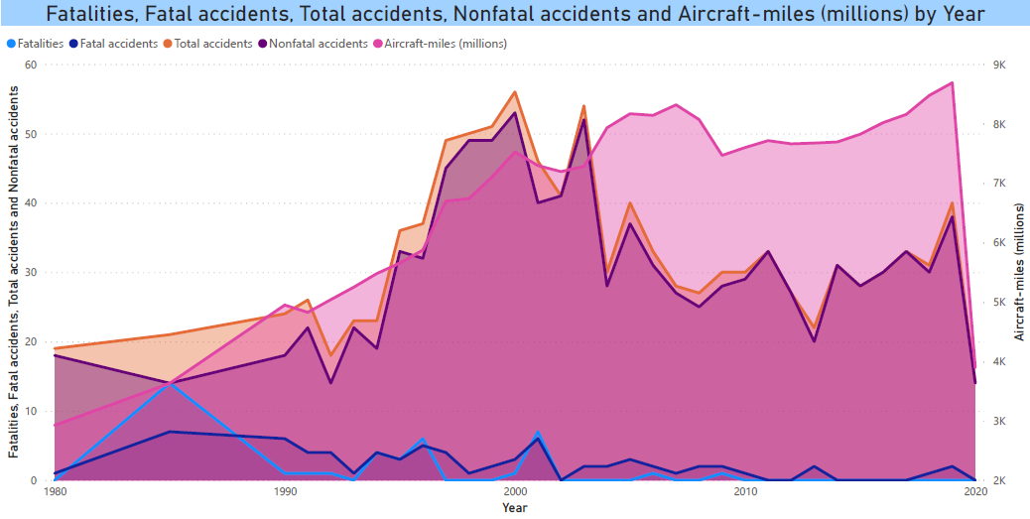

Slide 7
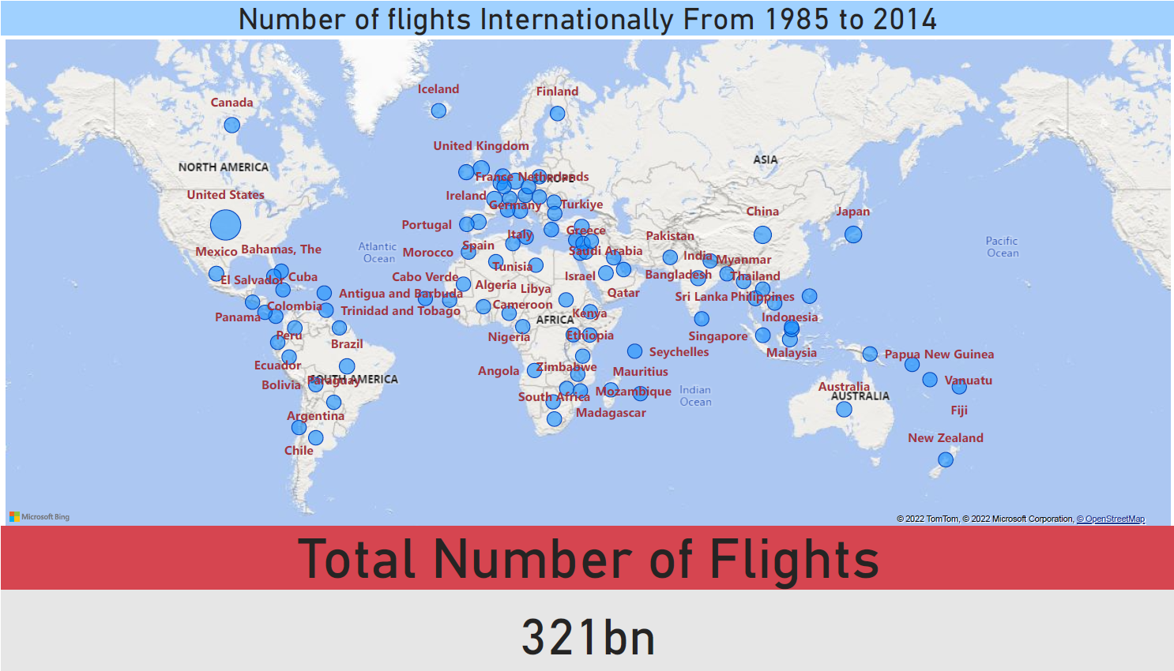

Slide 8
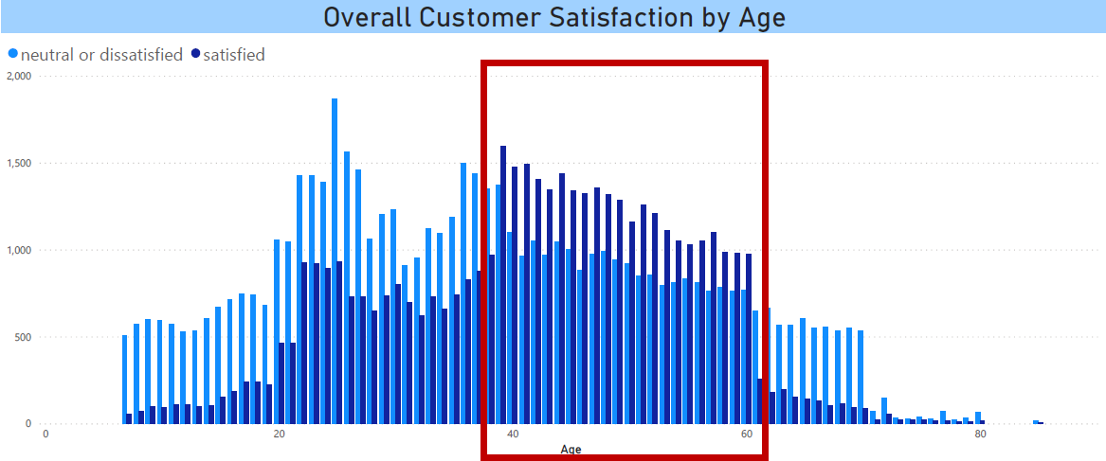

Slide 9
.. And something to amaze you…
Notes:
And I am going to leave you with a moving graph.
This graph shows the number of flights internationally from 1980 to 2020. The size of the bubbles is larger for higher numbers. Notice that in 1980 the highest number belonged to the US with under 1 billion. But as years progressed, the bubbles increase proportionally to the size and economy of those countries. US, China, Japan, UK, Russia are among the leaders. Air travel continues to be the most popular means of travel. Technology and regulations have helped make air travel safe. So next time you seat in an airplane, relax and enjoy the flight.

Slide 11
THANK YOU

